Slide 1

WHAT IS MVC?
By: Ribbal Hussain

Slide 2
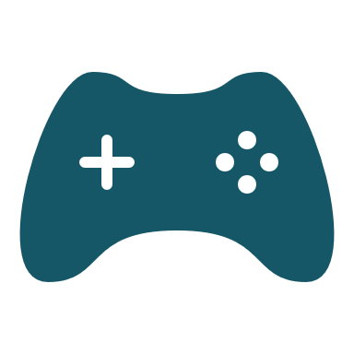
Model-View-Controller
MVC (Model-View-Controller) is a pattern in software design commonly used to implement user interfaces, data, and controlling logic. It emphasizes a separation between the software's business logic and display. This "separation of concerns" provides for a better division of labor and improved maintenance. Some other design patterns are based on MVC, such as MVVM (Model-View-Viewmodel), MVP (Model-View-Presenter), and MVW (Model-View-Whatever).

Slide 3
???

Slide 4
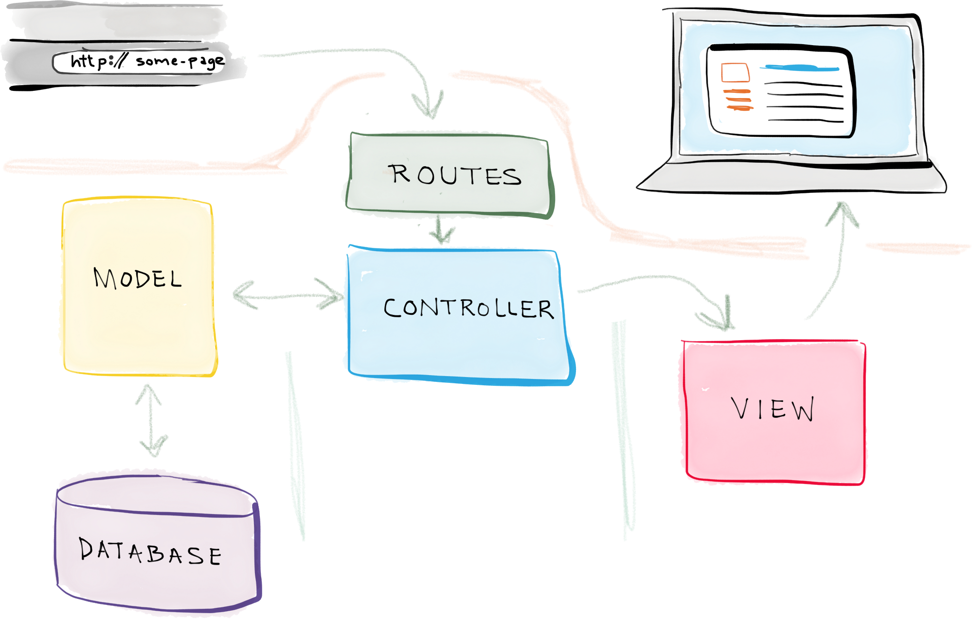
So, what is it?
MVC is short for Model, View, and Controller. MVC is a popular way of organizing your code. The big idea behind MVC is that each section of your code is separated and holds different functionality. One section of code may hold the data and the some other might direct what to do with said data.
MVC is a way to organize your code’s core functions into their own, neatly organized boxes. This makes modifying your code, revisiting it and sharing it among team members very easy.

Slide 5
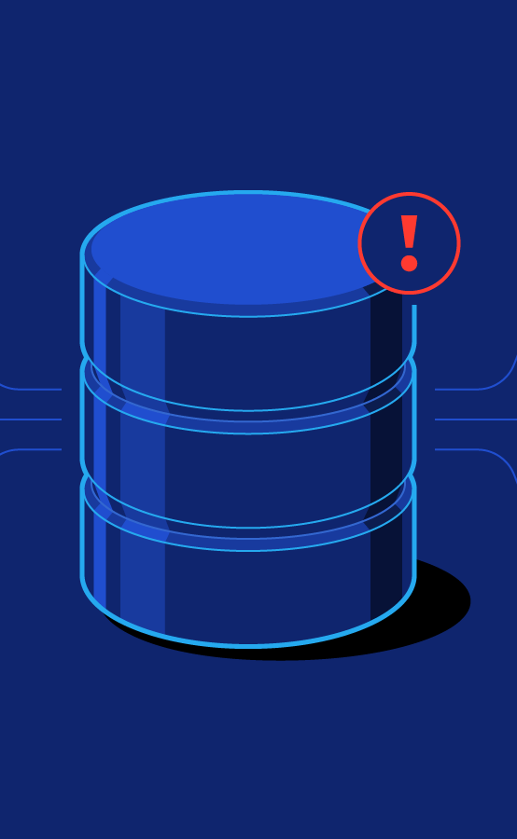
Model
The model is generally responsible for maintaining and managing the data. This can represent the data that is being manipulated from the database since the database is included in the model component. It responds from requests from the controller since each component is responsible for its own tasks, the controller does not communicate with the database by itself.

Slide 6
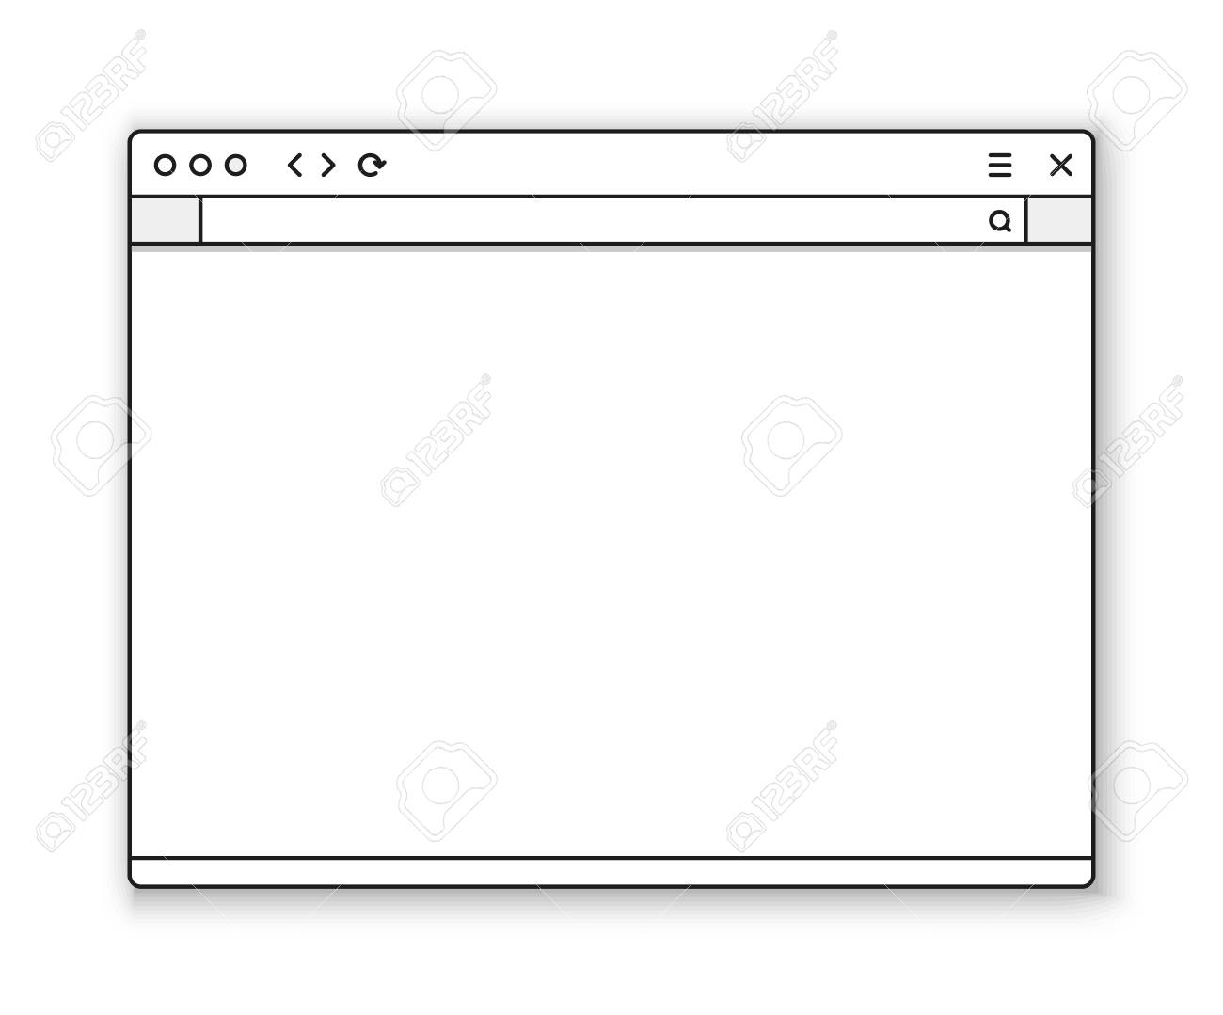
View
Data representation is done by the view component. It generates UI or user interface for the user. The view component takes the response from the controller and does not talk with the model directly.

Slide 7
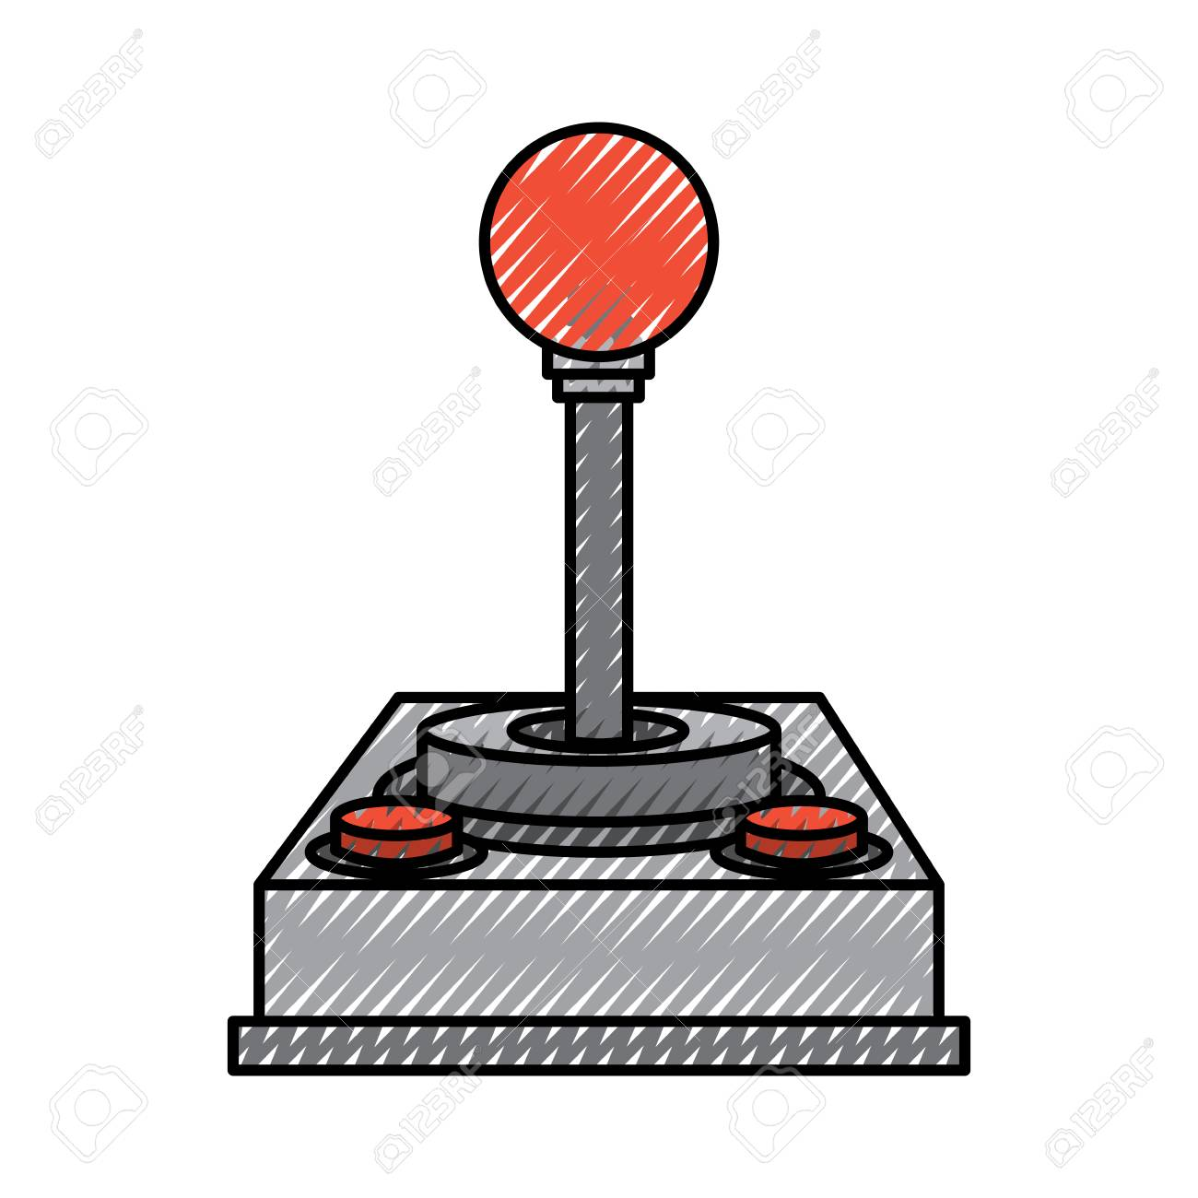
Controller
The controller is responsible for being the intermediary for the views and model, and controlling the flow of the application, it takes a request and sends a response. The controller takes all the information from the model and processes it and sends it to the view.

Slide 8
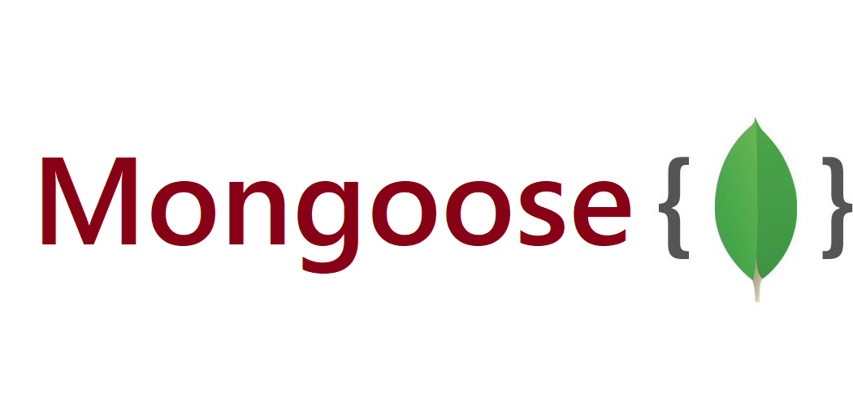
Mongoose
Mongoose is an Object Data Modeling (ODM) library for MongoDB and Node.js. It manages relationships between data, provides schema validation, and is used to translate between objects in code and the representation of those objects in MongoDB.
Mongoose allows for defining schemas for documents in a particular collection, this reduces risks of error and helps control the validation of data, by structuring the documents, and values for said data.

Slide 9
Now you are ready
Having understood all the details about the model-view controller paradigm, you are ready to build your full stack applications!

